Slide 1
Nature of Innovation
Some of this lecture is based on:
Salter & Alexy. 2014. The Nature of Innovation. In The Oxford Handbook of Innovation Management (syllabus reading)

Slide 2
Innovation Mantra
“Innovation as the industrial religion of the late 20th century” (The Economist)
Nothing new under the sun?!
The age is running mad after innovation; and all the business of the world is to be done in a new way; men are to be hanged in a new way. - Samuel Johnson (1771)
The United States led the world’s economies in the 20th century because we led the world in innovation. Today, the competition is keener; the challenge is toucher; and that’s why innovation is more important than ever. That’s the key to good, new jobs in the 21st century. That’s how we will ensure a high qualify of life for this generation and future generations. - Barack Obama

Slide 3
| Insightful Quotes from Johnson
The true measure of a man is how he treats someone who can him absolutely no good.
Your manuscript is both good and original; but the part that is good is not original, and the part that is original is not good.

Slide 4
Stylized Facts
Simplified representation of a set of empirical findings
Largely uncontroversial but not fully applicable to all settings
Helps to “concentrate on broad tendencies, ignoring individual detail” (Kaldor)
Stylized facts in the innovation literature?

Slide 5
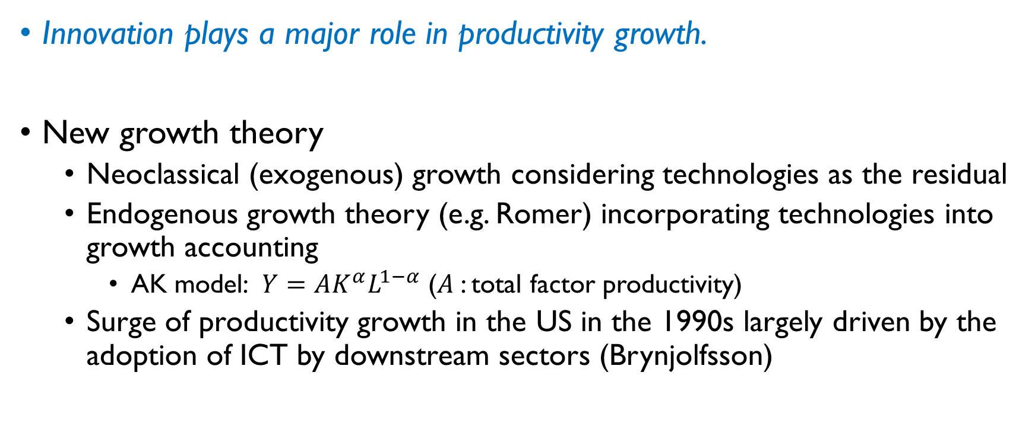
Innovation & Growth
Innovation plays a major role in productivity growth.
New growth theory
Neoclassical (exogenous) growth considering technologies as the residual
Endogenous growth theory (e.g. Romer) incorporating technologies into growth accounting
AK model: $Y=AK^{α}L^{1−α}$ ($A$: total factor productivity)
Surge of productivity growth in the US in the 1990s largely driven by the adoption of ICT by downstream sectors (Brynjolfsson)

Slide 6
Combinatorial Power of Innovation
Most innovation involves new combinations of existing elements, bodies of knowledge or technology.
Innovation as “new combinations” (Schumpeter)
Most innovations are not novel in themselves; only novel combinations of elements that already exist.
I invented nothing new. I simply assembled into a car the discoveries of other men behind whom centuries of work… Had I worked in fifty or ten or even five years before, I would have failed. … To teach that a comparatively few men are responsible for the greatest steps of mankind is the worst sort of nonsense. (Henry Ford)

Slide 7
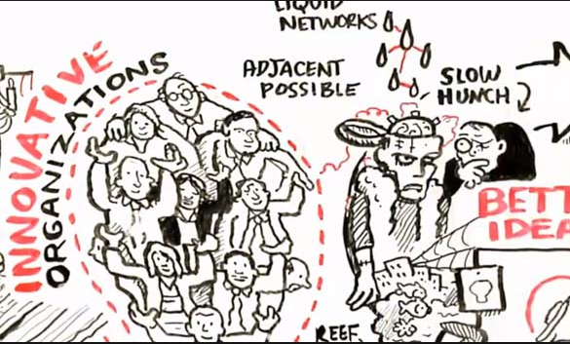

Combinatorial Power of Innovation
Where do good ideas come from?

Slide 8
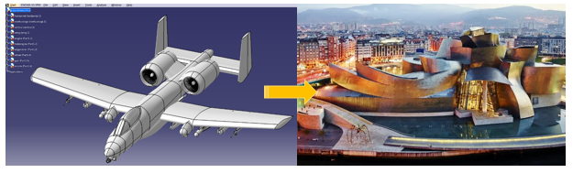
Pervasiveness of Innovation
Innovation is pervasive throughout the economic system.
While it seems innovation takes place in a few, high-tech sectors, innovation (with all different paces and directions) is pervasive across all parts of the economic system.

Slide 9
Pace of Innovation
Most change brought about through innovation is evolutionary, incremental adaptation of existing elements, products, and technologies.
Only 20% of industries underwent a major shake-up in market share of large incumbents in the US (McGahan 2004) → Most workers of the average industry work their entire lives without ever experiencing a radical innovation happening in their industry.
Bulk of corporate investment is directed towards incremental innovation, looking for small improvements in existing products/processes/services.
Expensive to build up, R&D teams of many firms tend to focus on the tried and tested, near-market innovations

Slide 10
| Top Engineering Feats of the 20th Century (NAE)
Automobile
Internet
Highways
Airplane
Household appliances
Telephone
Nuclear technologies
Water supply
Air conditioner
Laser & fiber optics
Computers
Electrification

Slide 11
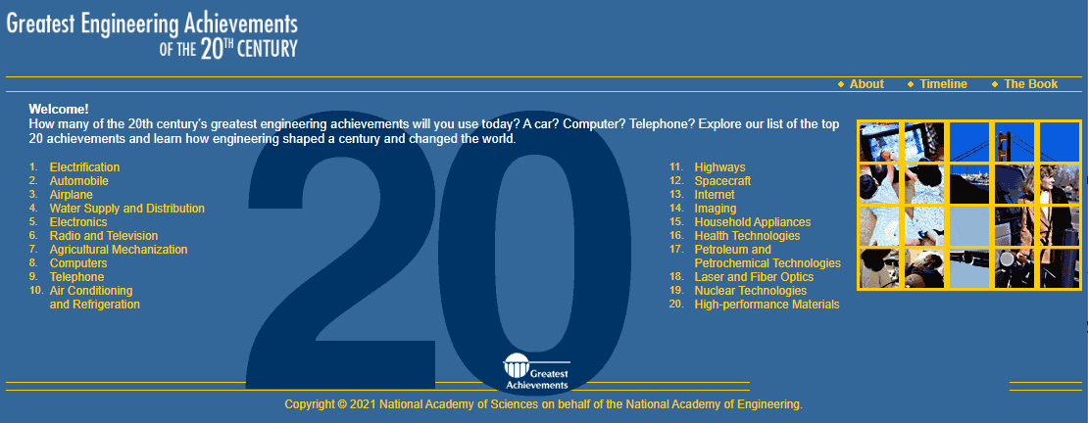
| Top Engineering Feats of the 20th Century (NAE)

Slide 12
Pace of Innovation
Radical and revolutionary changes are rare and largely unknowable.
GPT (general purpose technologies) having a wide range of applications across different industries/sectors
Synthetic nitrogen (revolutionizing food production)
Information technology
Artificial intelligence?
The challenge is that sources and timing of a radical innovation are unpredictable, with the history full of the predictions that went wrong.

Slide 13
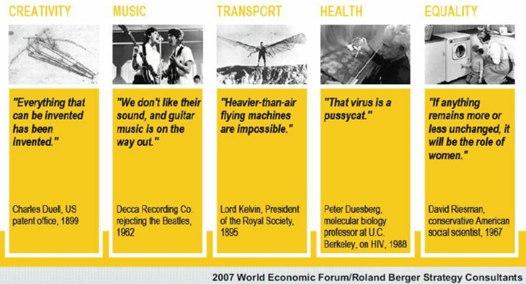
Pace of Innovation

Slide 14
| Tracing Innovation
Promising technologies now vs. in the future
Ex-ante | Ex-post
 | Promising | Not
Promising | True Positive | False Positive
Not | False Negative | True Negative

Slide 15
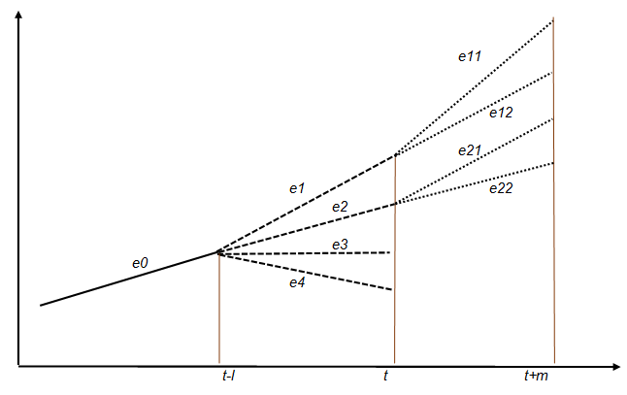
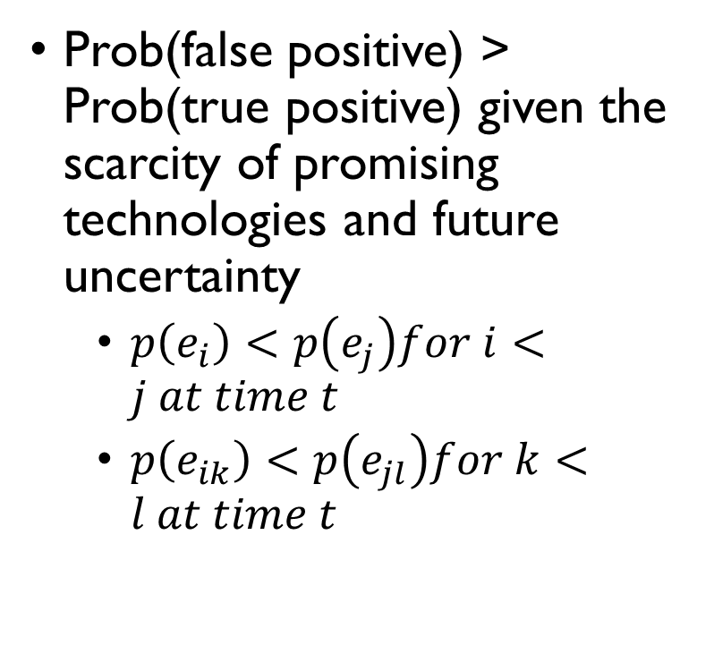
| Tracing Innovation
Prob(false positive) > Prob(true positive) given the scarcity of promising technologies and future uncertainty
$p\left(e_{i}\right)<p\left(e_{j}\right)for i<j at time t$
$p\left(e_{ik}\right)<p\left(e_{jl}\right)for k<l at time t$

Slide 16
| Tracing Innovation
Even for a true positive, it’s hard to evaluate whether it is due to developments internal to technologies or due to external environments.
Endogenous factors | Exogenous factors
 | Yes | No
Yes | A | B
No | C | D

Slide 17
Innovation is Relational
Innovation usually involves collaboration between two or more parties.
Individuals may provide spark or direction for great innovations but it is essentially teams of individuals that do the hard graft of turning ideas into innovations.

Slide 18
Creativity, Invention, and Innovation
Creativity is as critical to invention, as invention is to innovation, but these concepts are separate and distinct elements of the innovation process.
Large literature on the source of creativity and novelty
Focusing on individuals (e.g., innate skills or abilities) → “nature vs. nurture” debate, extrinsic vs. intrinsic motivation
Note, however, that many creative ideas have no practical applications!
Creativity is not always directed towards invention and later innovation.

Slide 19
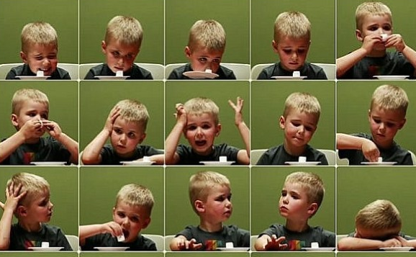
| Marshmallow vs. Polaroid
Marshmallow test
Stanford experiment on delayed gratification (Mischel, et al. 1989)
Teresa Amabile’s polaroid experiment (Amabile 1996)
Highest levels of creativity require intrinsic motivation.
Evaluation (or Reward) | Creative Task
 | Algorithmic (tasks taking a linear series of steps) | Heuristic (tasks exploring many possibilities)
Summative | Positive | N.A.
Formative | Negative | Positive

Slide 20
Capturing Returns from Innovation
Most innovations fail to capture returns from their innovative efforts and capturing returns from innovation requires different skills from creating innovations.
Skills required to generate innovations significantly different from skills required to capture their returns
Importance of complementary assets (e.g., marketing or sales forces) to enable a successful commercialization of an invention
LG smartphone?

Slide 21
Varieties of Innovation
There is a vast array of different types of innovation.
Innovation come in many forms and types.
Product vs. process innovation
Disruptive innovation (Christensen)
Open innovation (Chesborough)

Slide 22
Patterns of Innovative Activity
There are ‘regular’ patterns in innovative activity over time, and strong complementarities between different types of innovation.
Product life cycle (PLC) (Abernathy & Utterback 1978)
Firms placing varying emphasis on production and process innovation over the life cycle of a technology
Fluid stage
Transitional stage
Specific stage
Firms propose an array of different products and designs incorporating new technologies
A dominant product design emerges, while not necessarily the highest performing product
The product becomes a commodity and concerns about production cost are dominant resulting in innovation activities to optimize process technologies

Slide 23
Geography of Innovation
Innovation is a ‘sticky’ activity in which location matters.
Certain types of knowledge will not travel far.
Regional clusters
“Global” regional clusters (e.g., Silicon Valley), catch-up clusters in latecomer countries
Need to balance local links with global pipelines to ensure diversity in knowledge inputs and pathways to markets

Slide 24
Organizational Routines of Innovation
There is a clear set of organizational routines that can help organization to better manage the innovation process.
Good projects may be killed by internal stage-gate process against established ways of working.
Mechanisms of supporting different types of innovation (e.g., organic, fluid organization vs. formal structures routinizing/scaling up innovation)
Open space/office movement
Google’s 80/20 policy (allowing employees to dedicate 20% of their time for creative side projects)

Slide 25
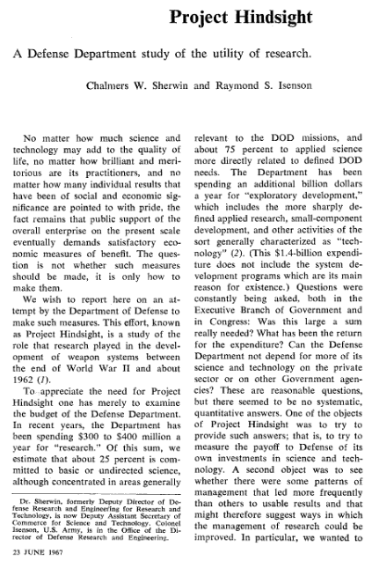
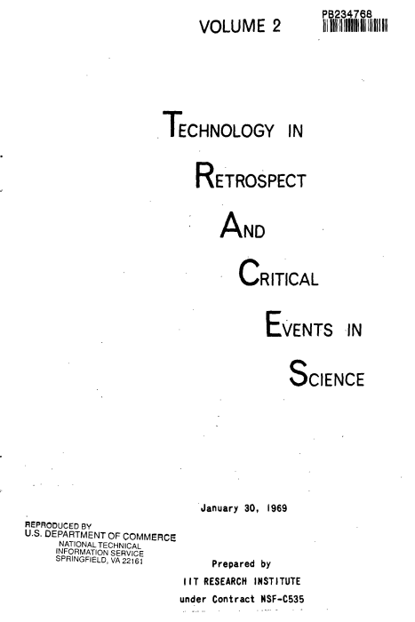
Sources of Innovation
Where does innovation come from?

Slide 26
| Project HINDSIGHT
Commissioned by US DOD (1963~67)
Roughly 25% of DOD R&D was then spent for basic (unoriented) research
Analyzed 20 important weapon systems (e.g. Polaris, nuclear warheads, Mark 46 torpedo) developed in the last 20 years
Identified 686 “research or exploratory development events” among which
Only 9% were regarded as scientific research done in universities
Concluded
Scientists contributed most effectively when their effort was mission-oriented.
The lag between initial discovery and final application was shortest when the scientist worked in areas targeted by the sponsor.
Source: Chen, Chaomei (2011), Turning Points: The Nature of Creativity. Springer

Slide 27
| Project TRACES
Commissioned by US NRF (1967-69) to find out how long it would take for basic research to evolve to the point that potential applications become clear.
Examined the history of five inventions (dated as early as 1850s) – video tape recorder, electron microscope, contraception pill, matrix isolation, ferrites
Identified 340 critical research events and classified them into mission-oriented, non-mission-oriented, and development/application
70% were non-mission research, 20% mission-oriented and 10% development/application
75% of non-mission and 1/3 of mission-oriented research events occurred before the conception of the ultimate inventions.

